Slide 1
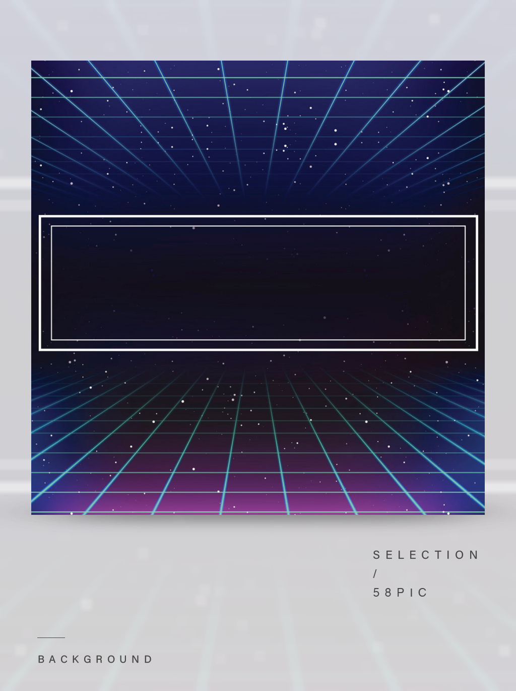

Waste Recycling
System
By Wonder Four

Slide 2
CONTENT
01
Demand analysis
02
Function realization
03
In summary

Slide 3
01
Demand analysis

Slide 4
In recent years, China's economy has developed rapidly, but our environment
pollution has been a big problem, the protection of the environment has become
a major concern. For example, waste batteries, if being discarded at will, will
cause serious harm to human beings. And waste plastic, if being discarded at will,
will lead to crop loss because it needs a very long time to dissolve. What's more,
if plastic is eaten by animals, it will make animals ill and dead. Therefore, the
waste recycling system can not only achieve the recycling of resources, but
also protect the environment.

Slide 5
02
Function realization

Slide 6
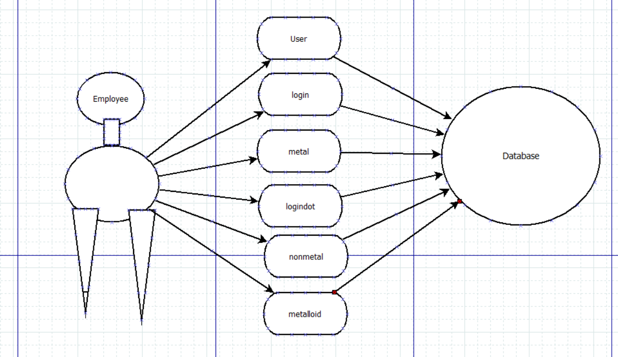

Slide 7
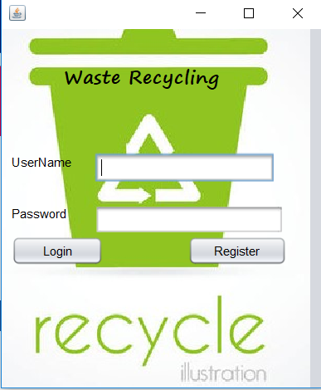
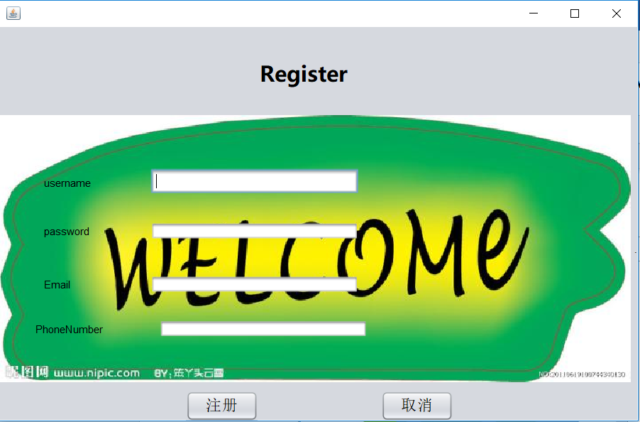

Slide 8
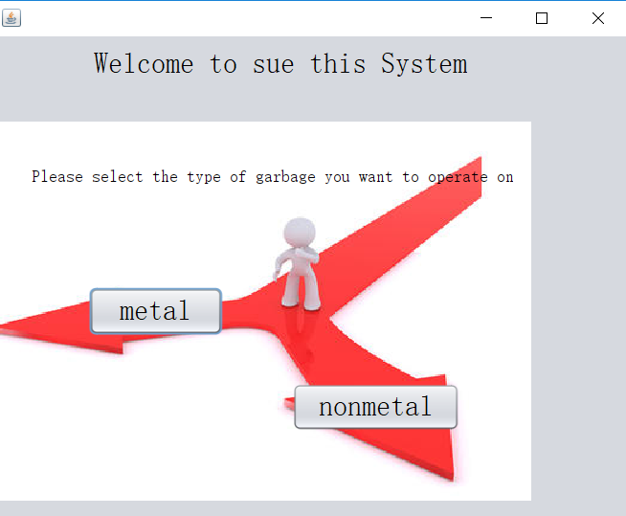

Slide 9
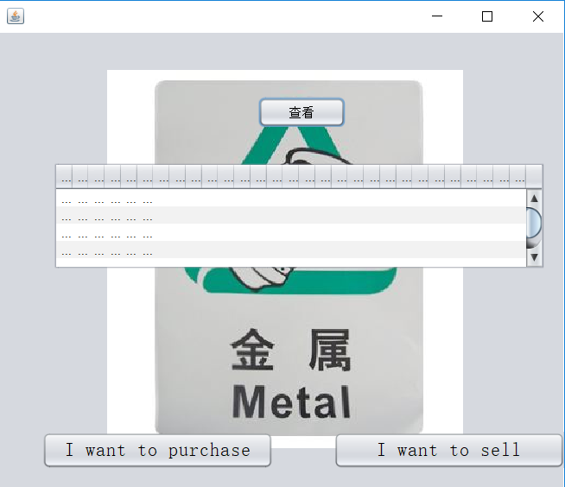

Slide 10
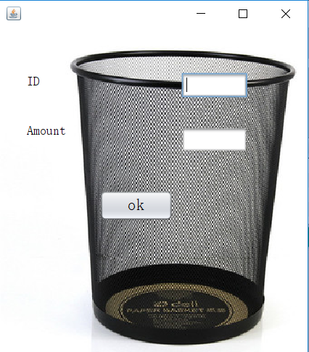

Slide 11
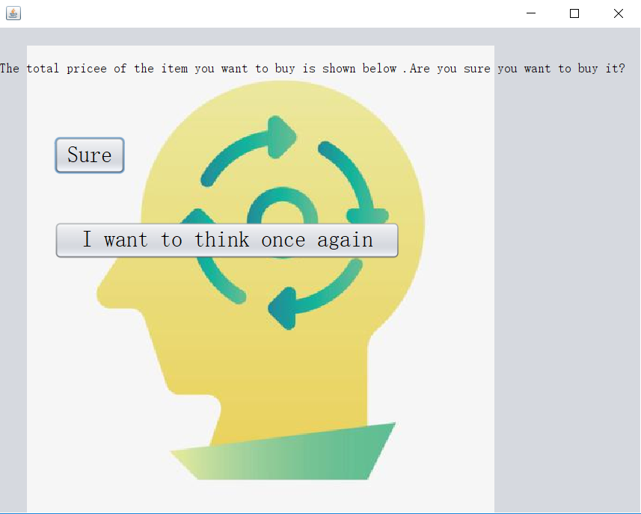

Slide 12
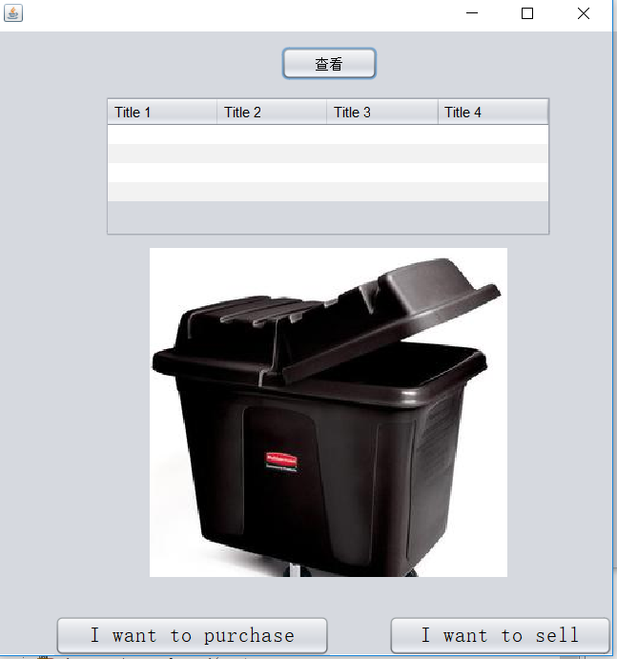

Slide 13
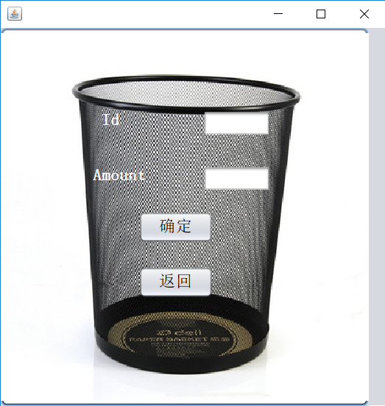

Slide 14
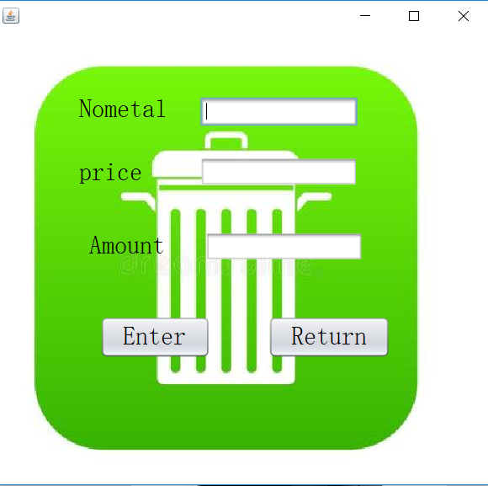

Slide 15
03
In summary

Slide 16
The procedure needs to be improved and we will continue to improve it.

Slide 17
THANKS~

